Slide 1
Presentation on
“Movie Ticket Booking System”
Submitted by: Project Guide:
Sandeep Dixit(220350320115) Ms. Somya Anuganti
Santosh Kumar(220350320117)
Shambhuraj Sharad Patil(220350320122)

Slide 2
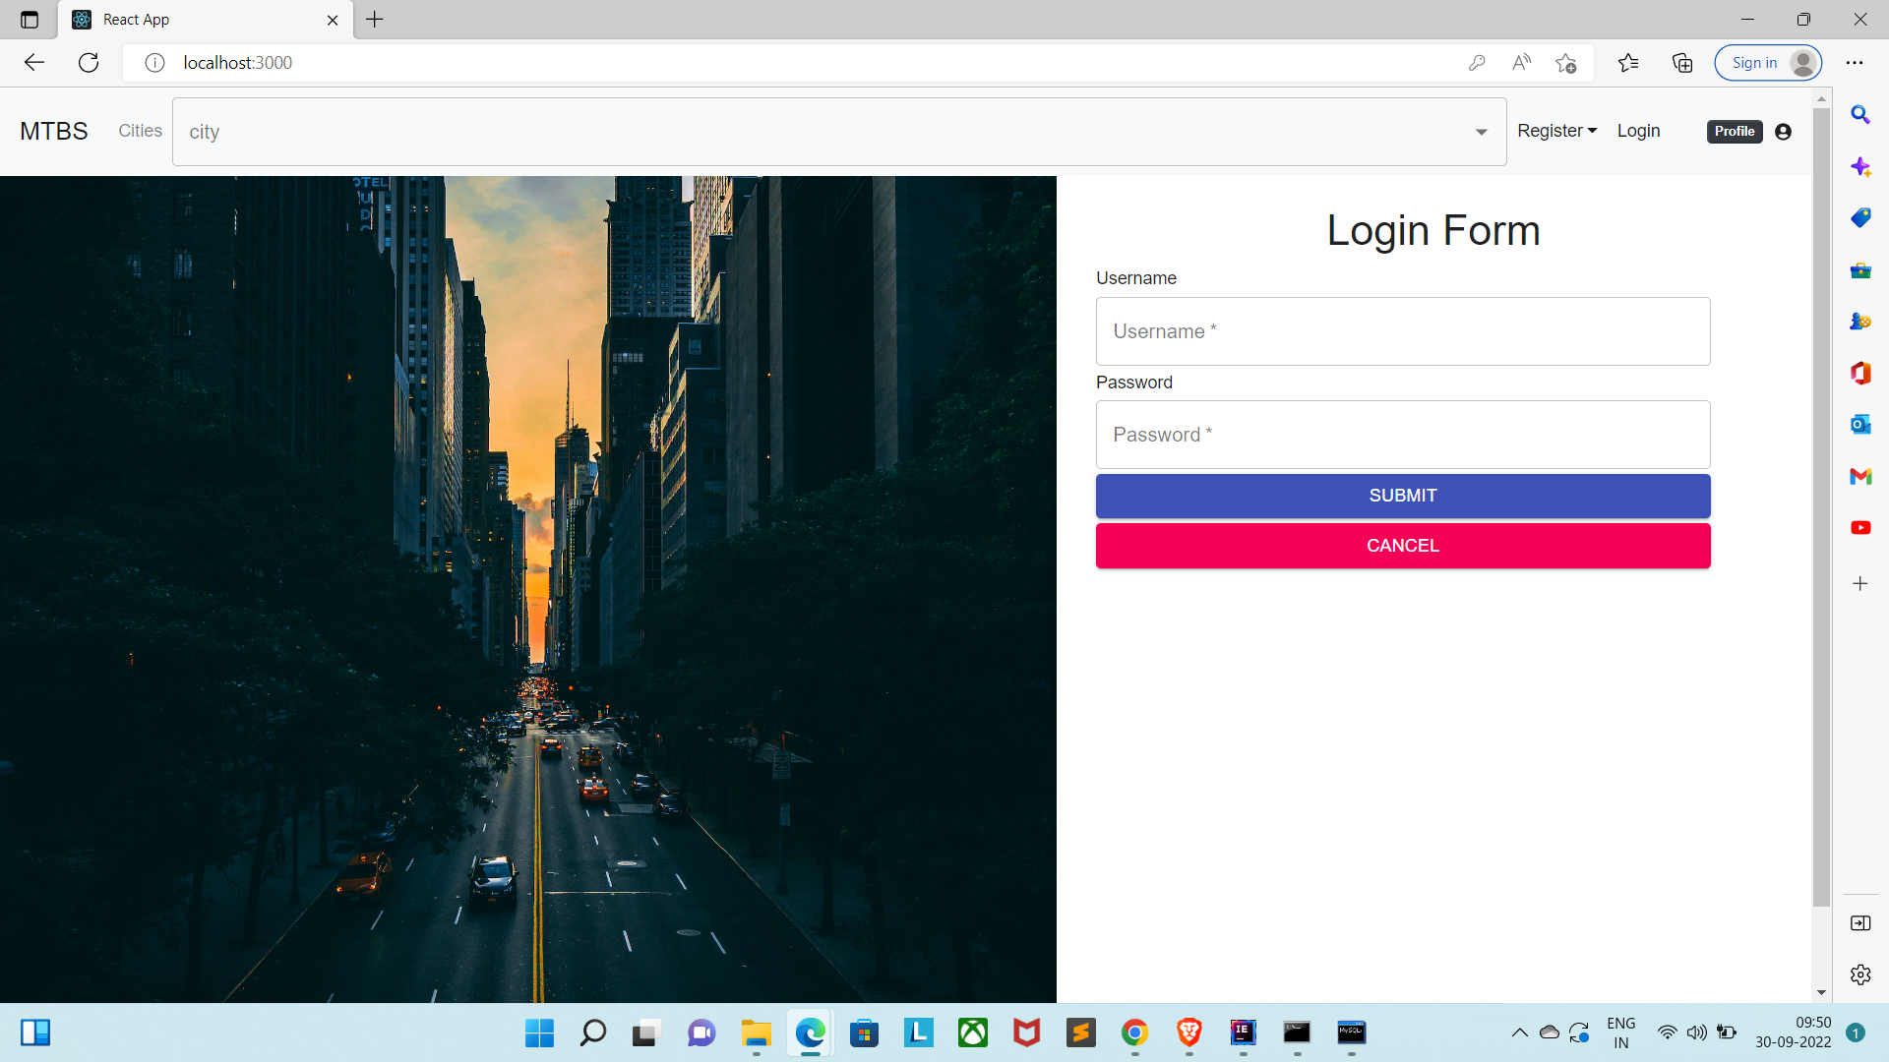
Home Page

Slide 3
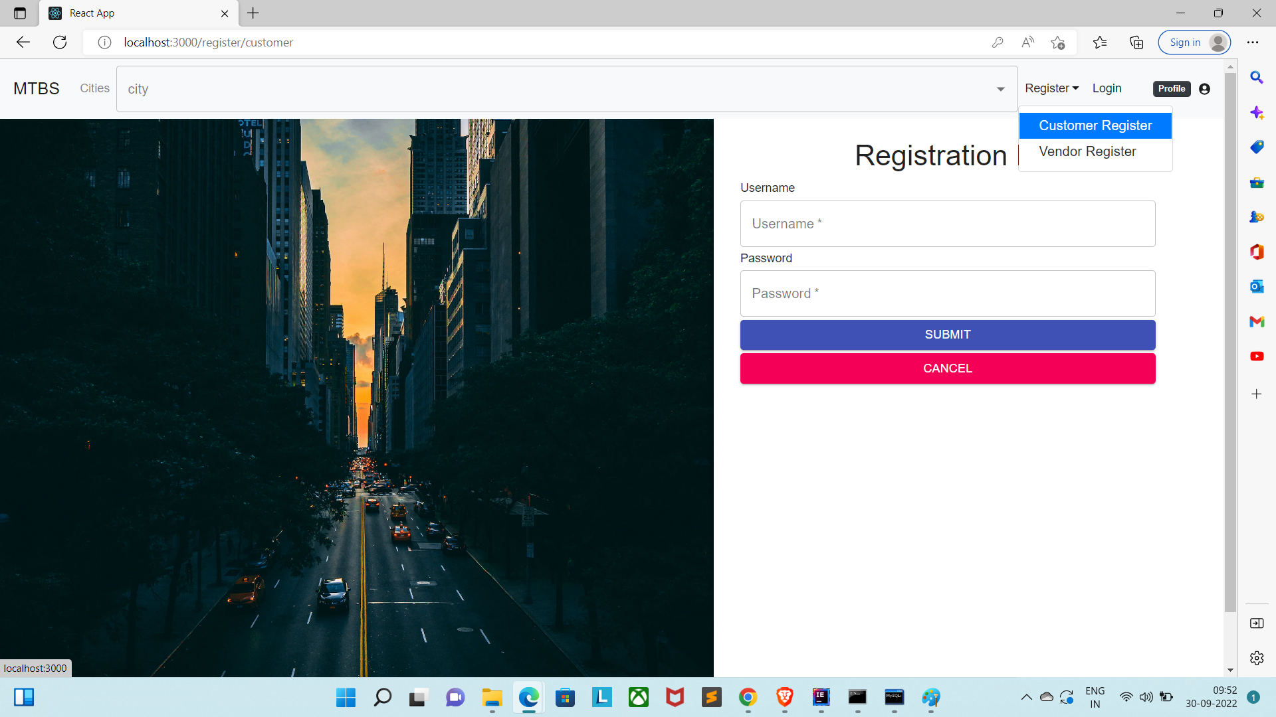
Registration Page:

Slide 4
Login Page:

Slide 5
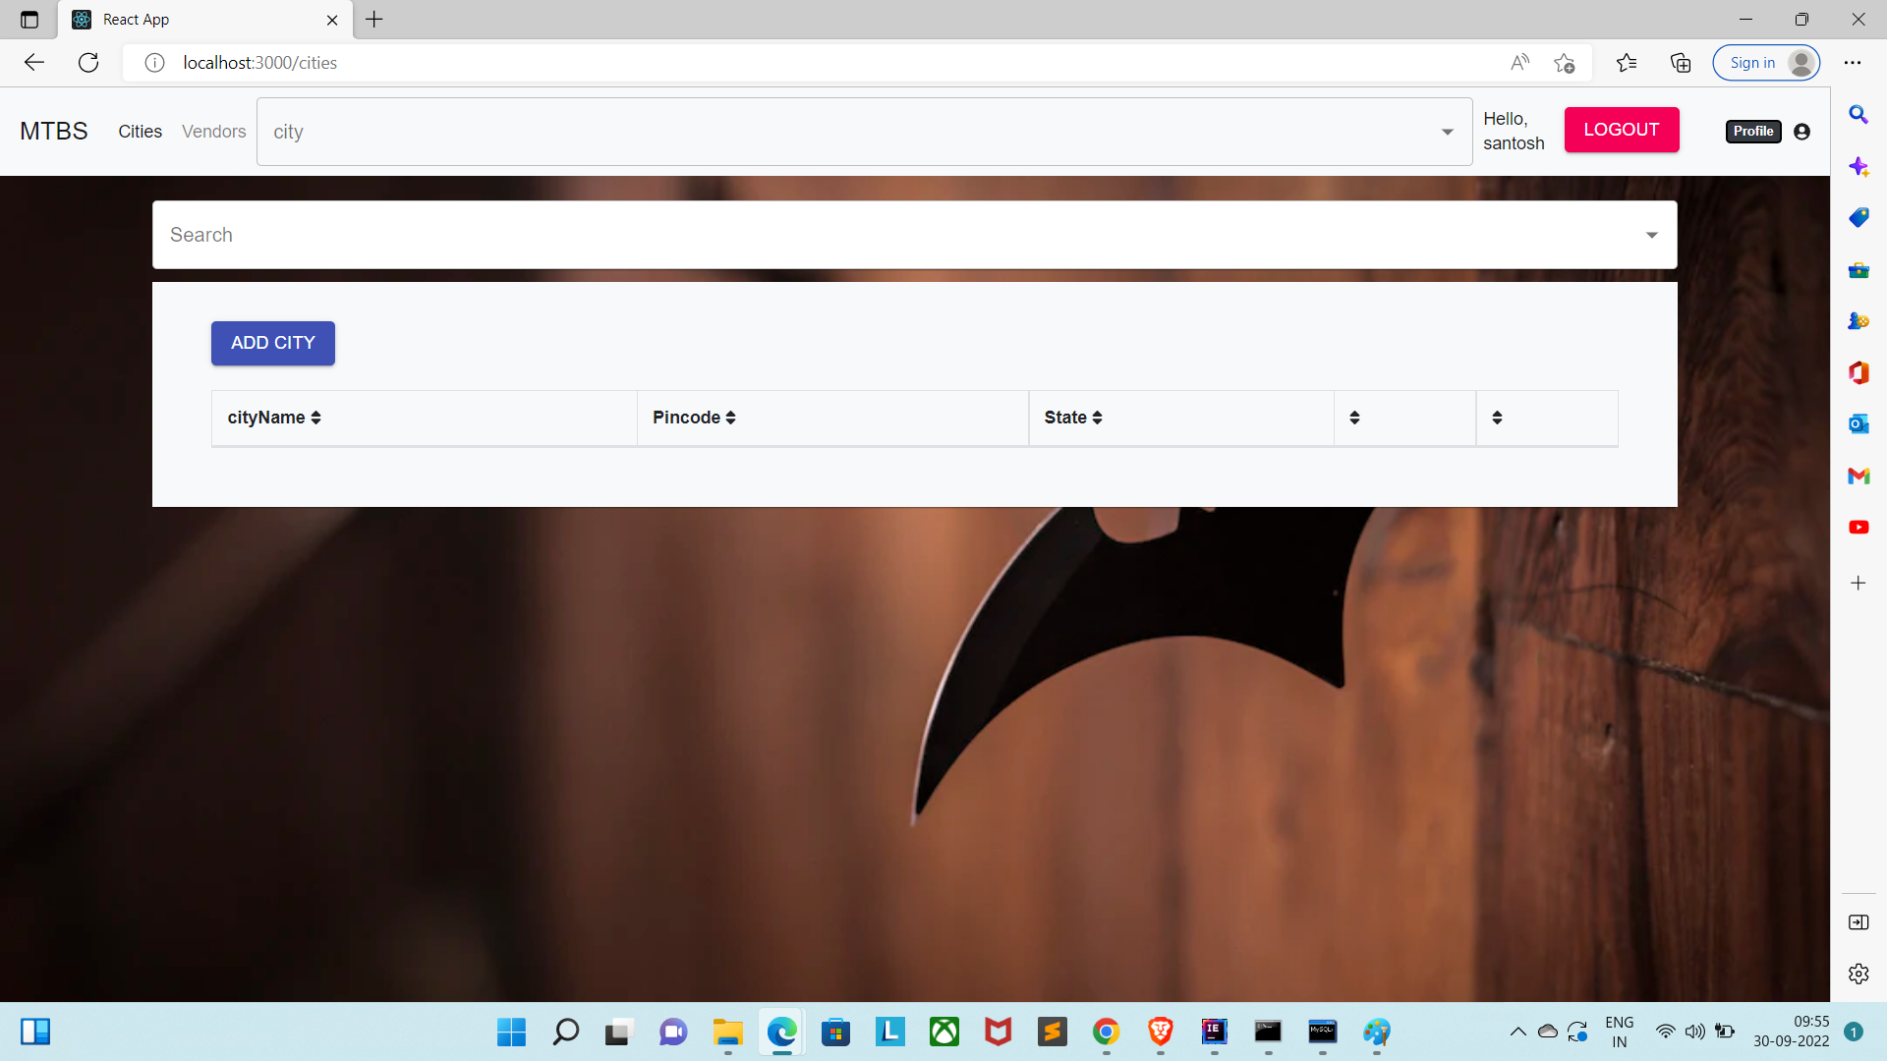
Admin Page:

Slide 6
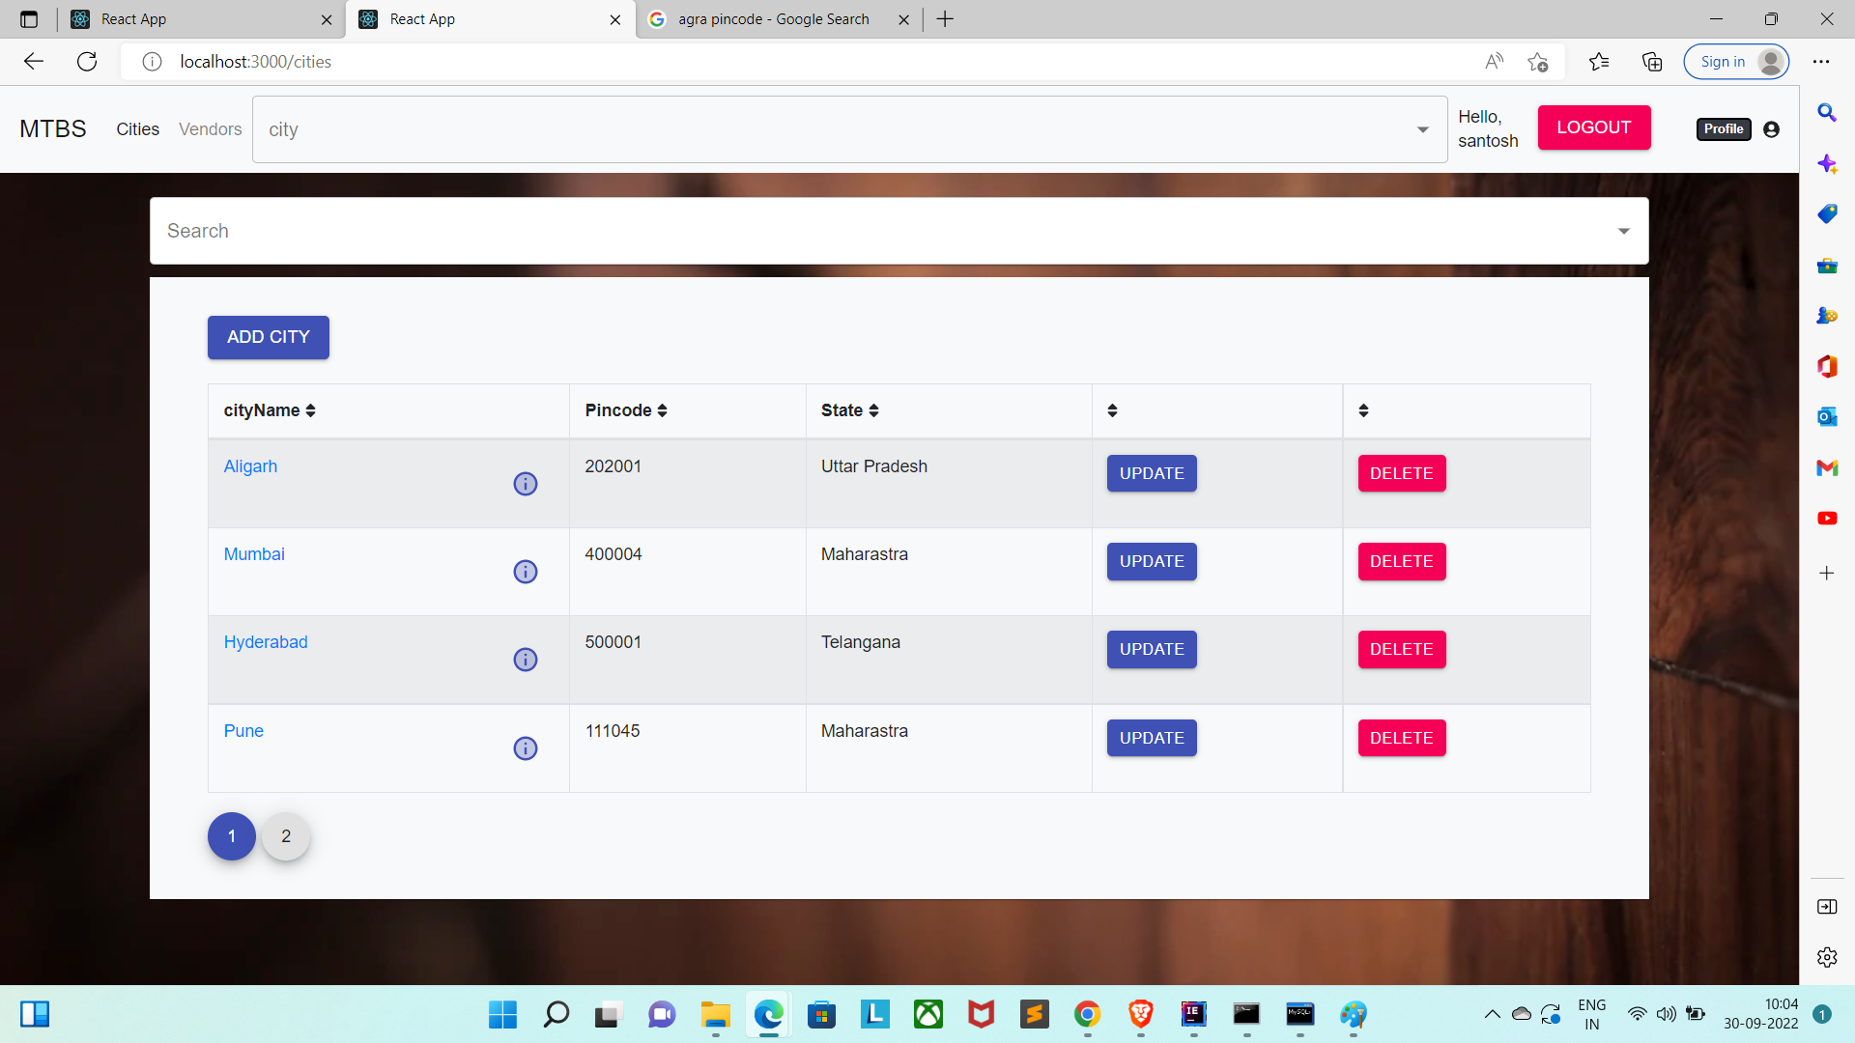
Admin Page/add city:

Slide 7
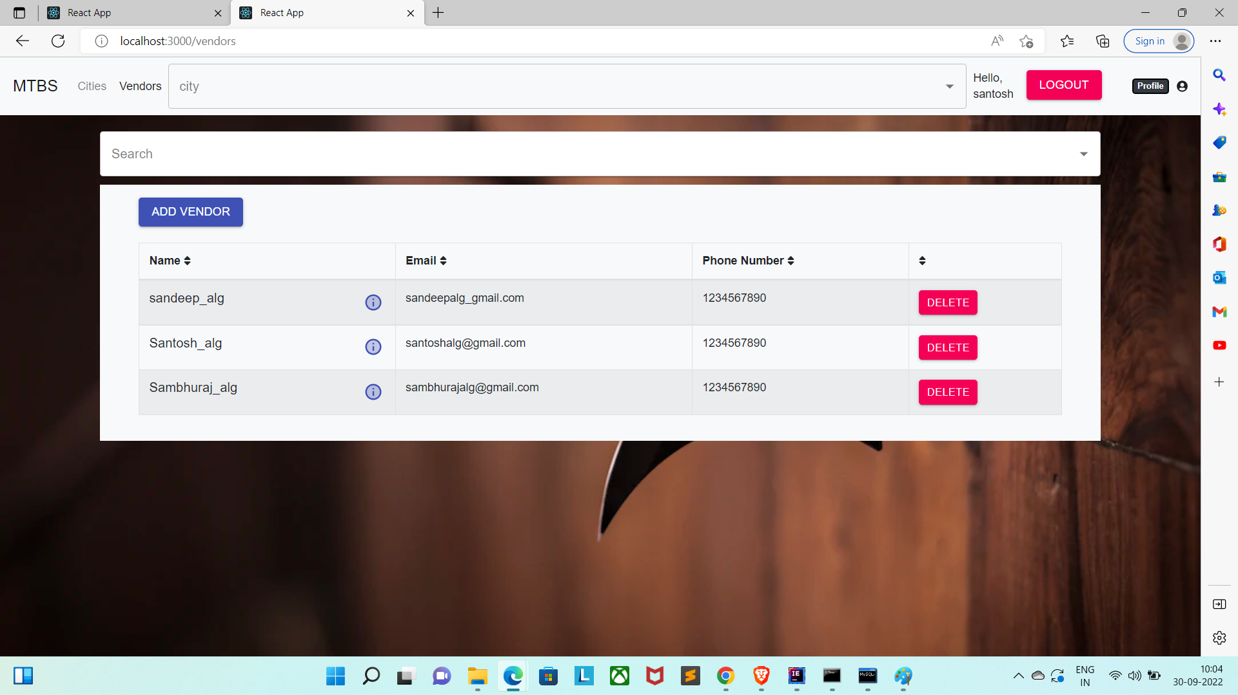
Admin Page/Add Vendor :

Slide 8
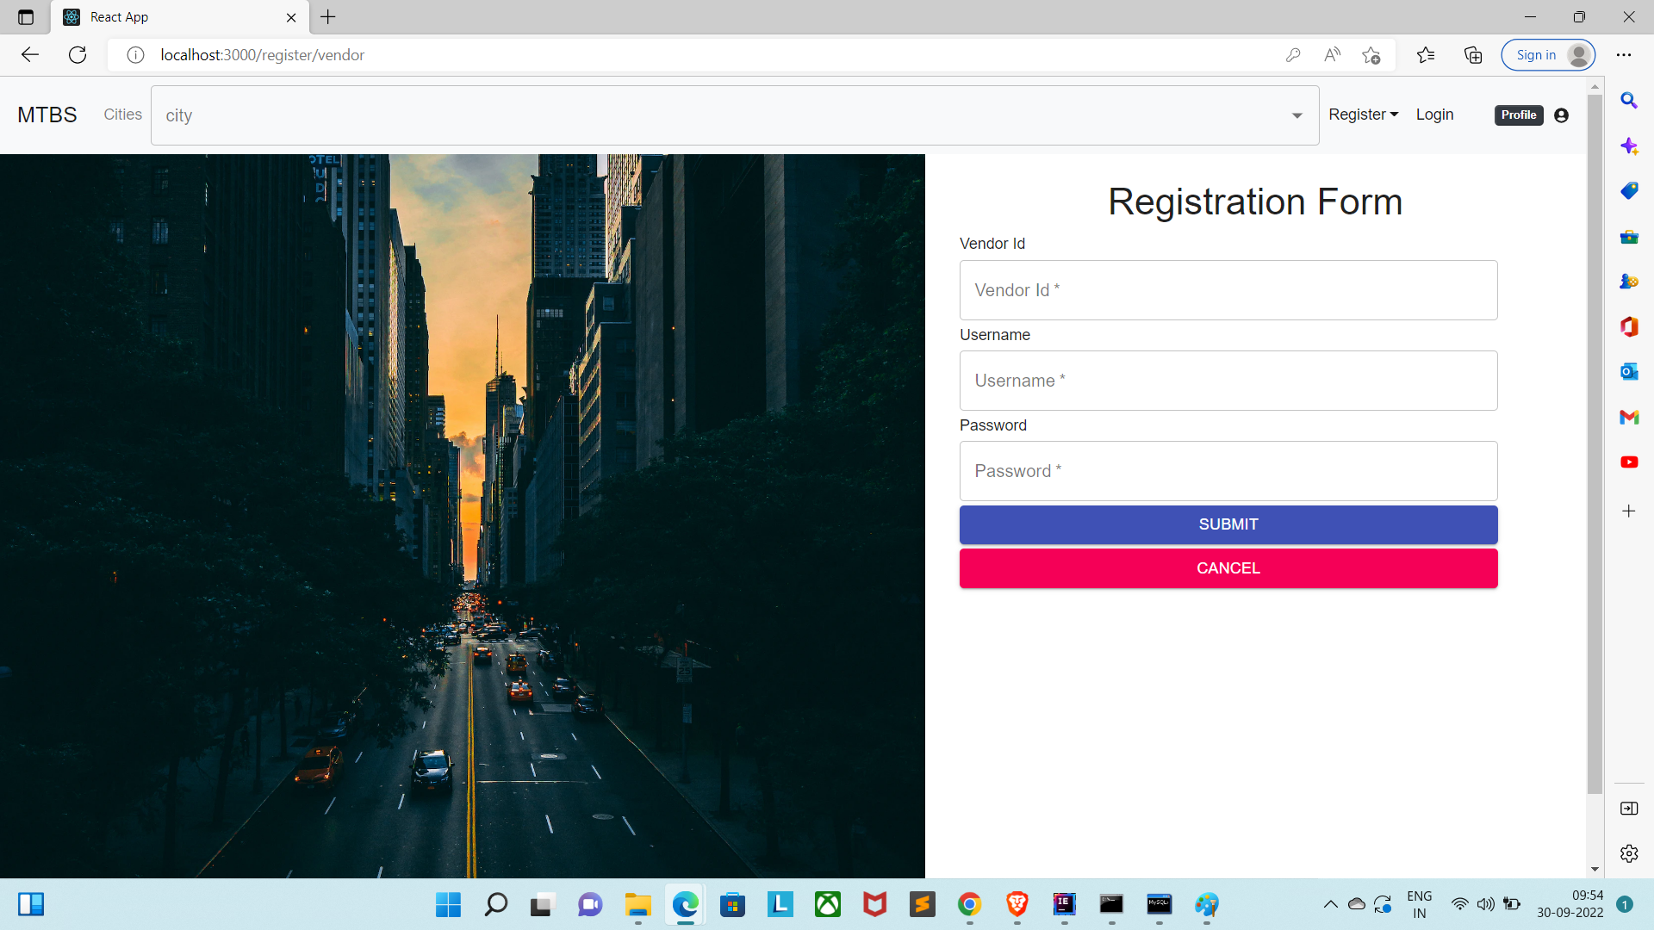
Vendor Registration Page:

Slide 9
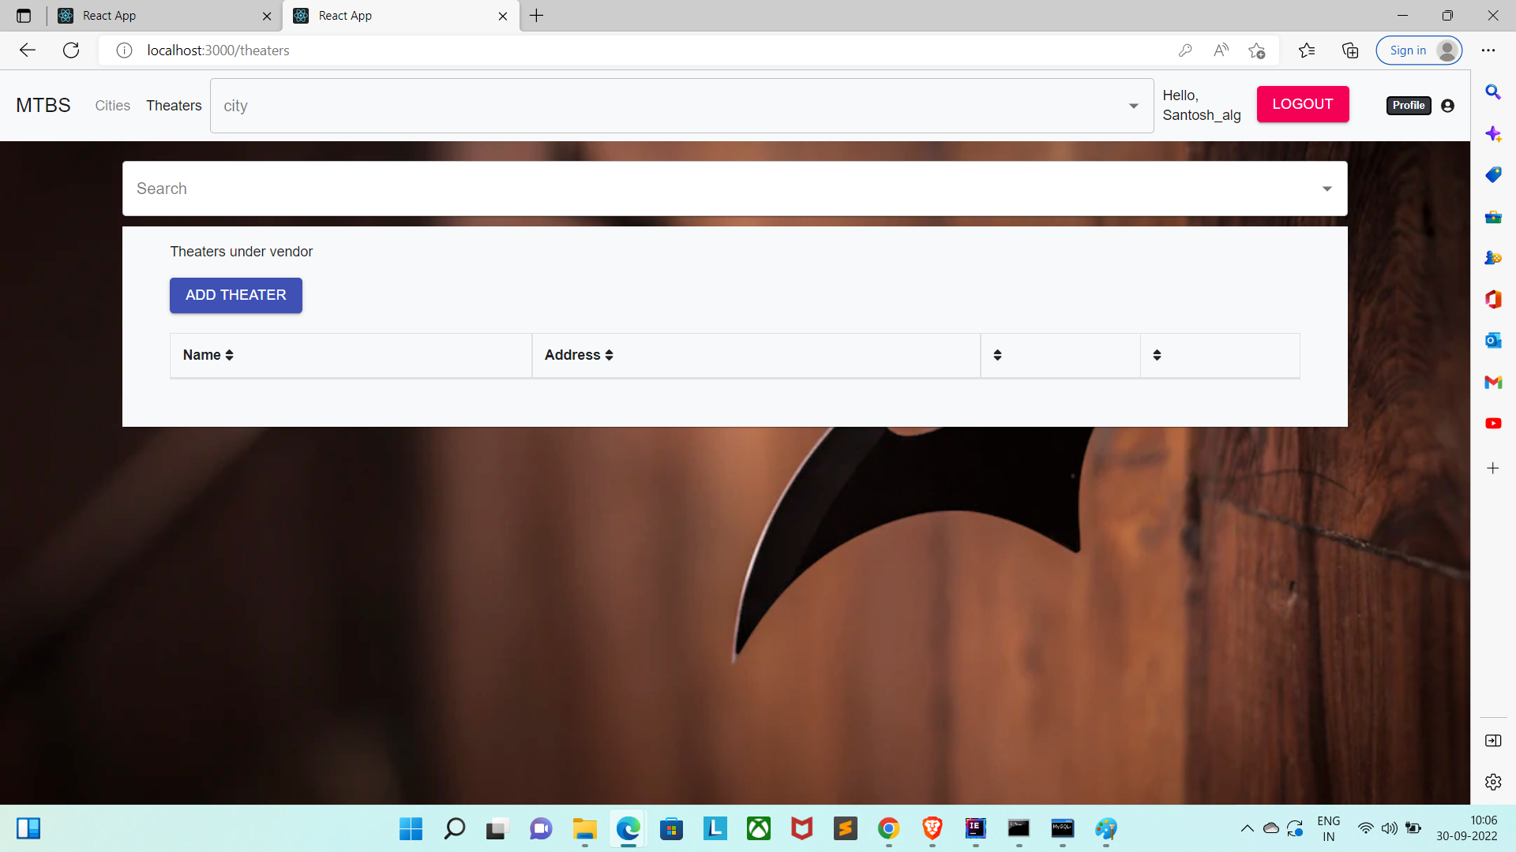
Vendor Page/Add Theatre:

Slide 10
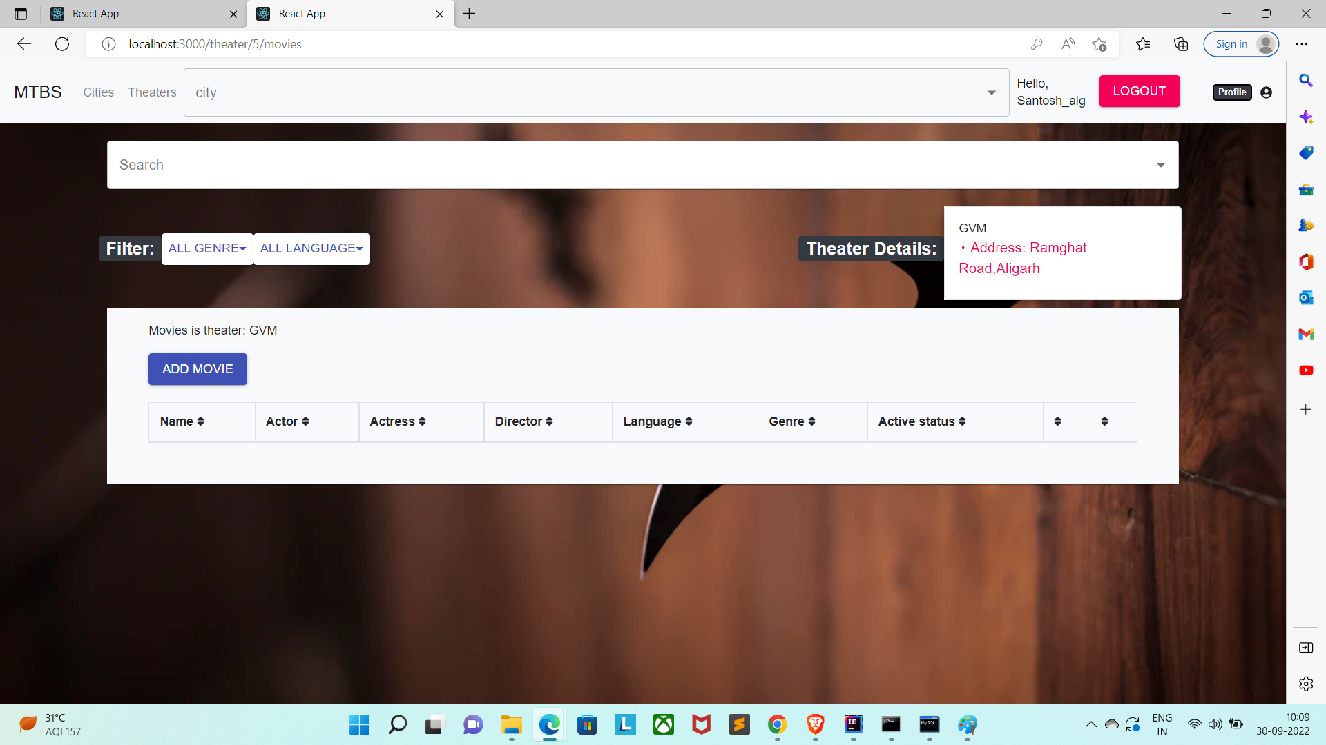
Vendor /Add Movie Pages:

Slide 11
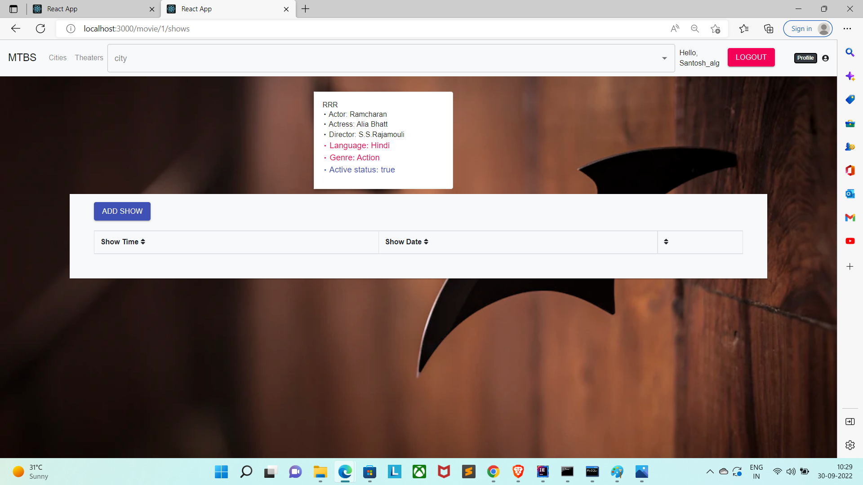
Vendor/movie/add show page:

Slide 12
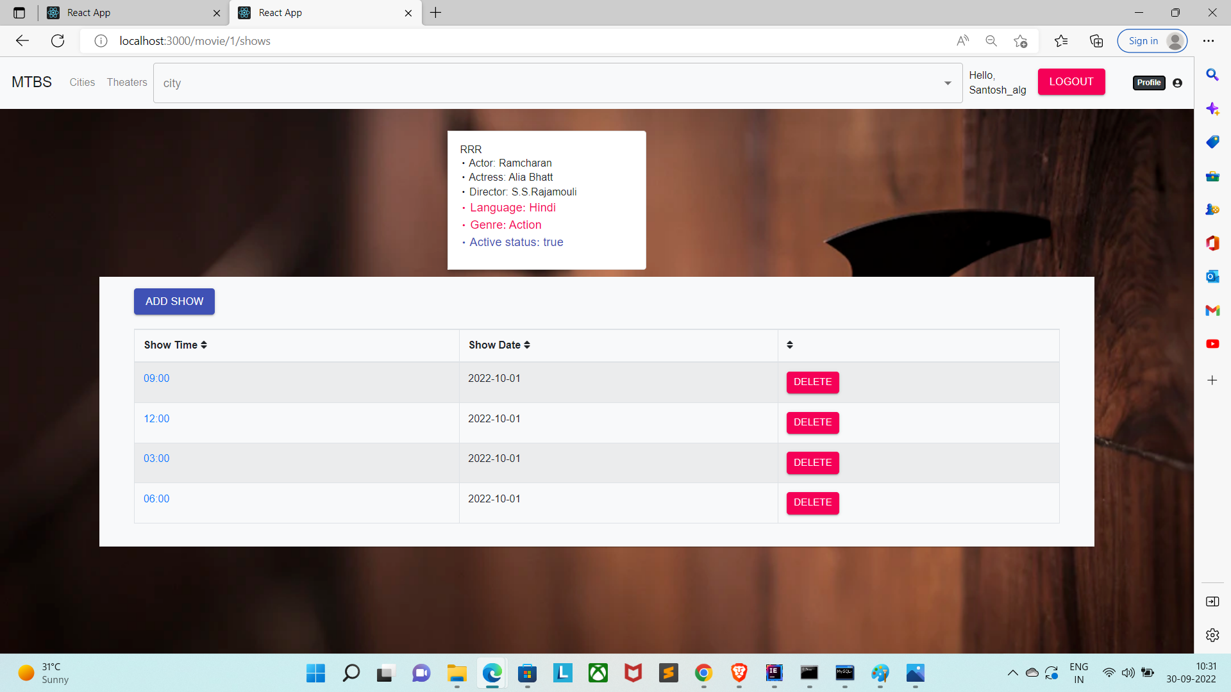
Vendor/movie/show/add show time:

Slide 13
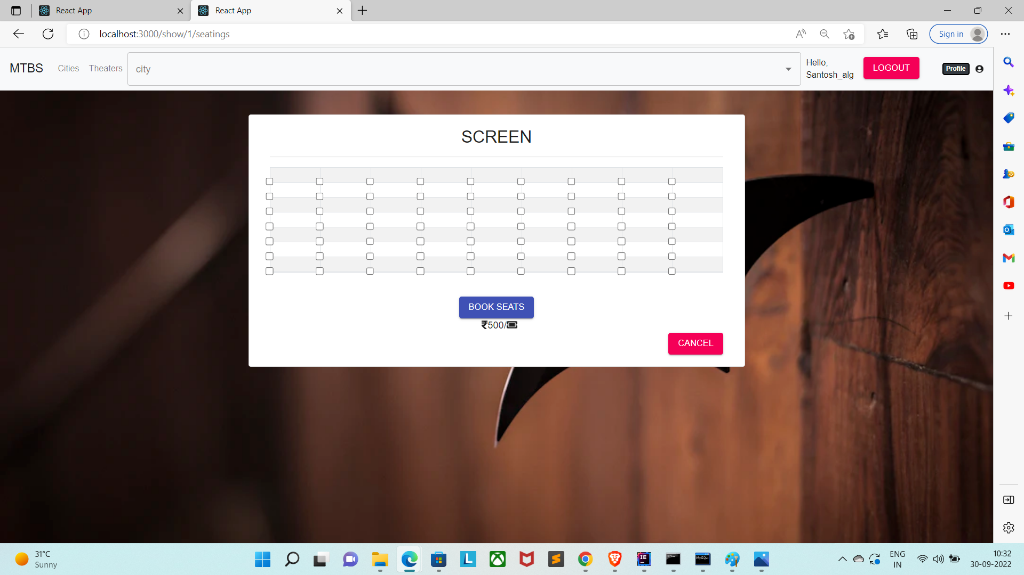
Vendor/city/movie/show/showtime/seating :

Slide 14
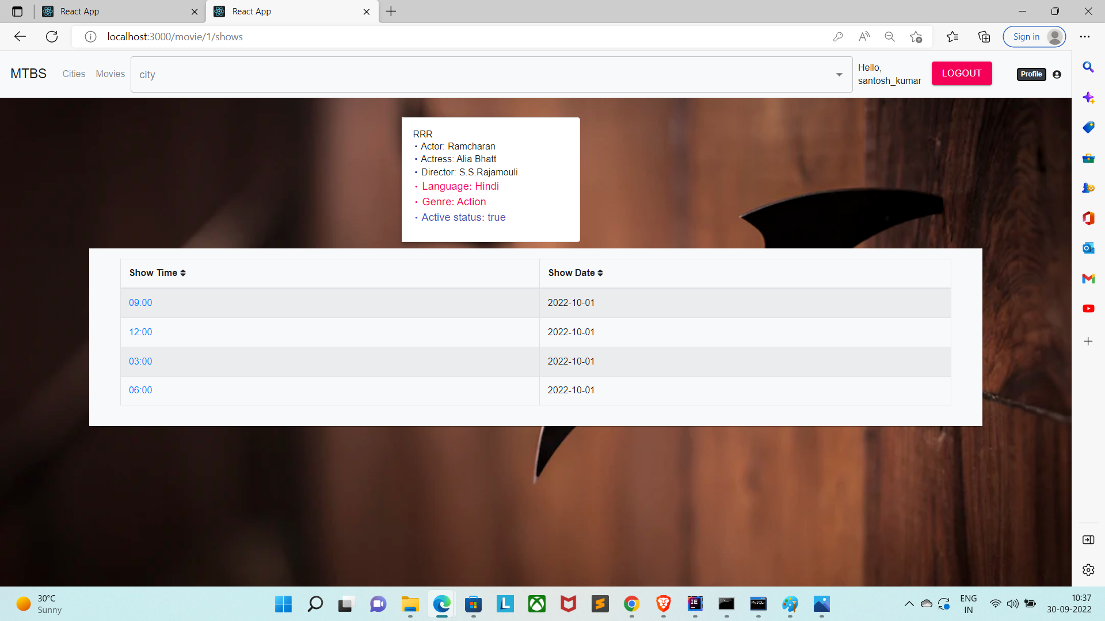
Customer/movie/show time

Slide 15
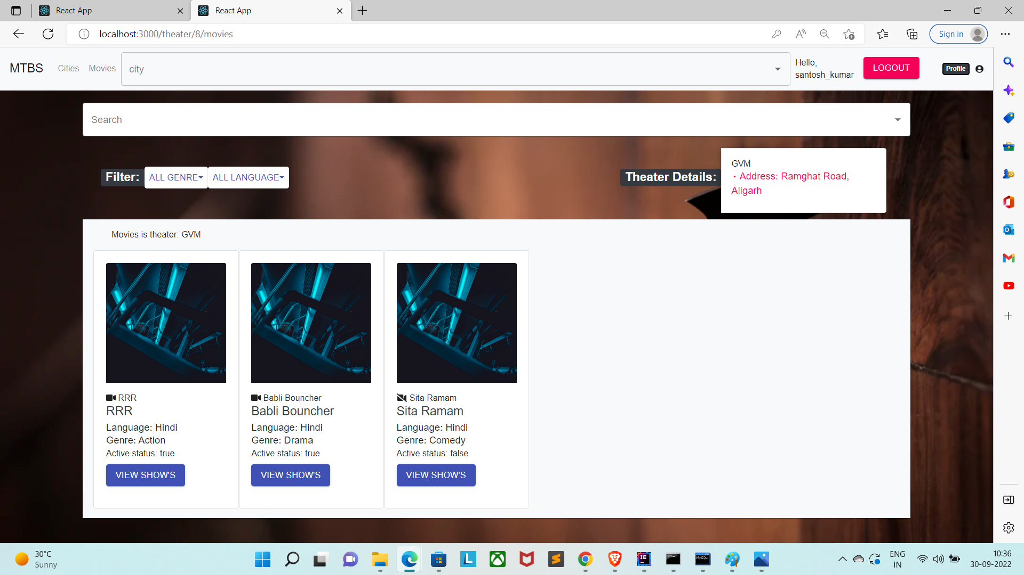
Customer/movie:

Slide 16

Customer/movie/show/select_seats Page:

Slide 17
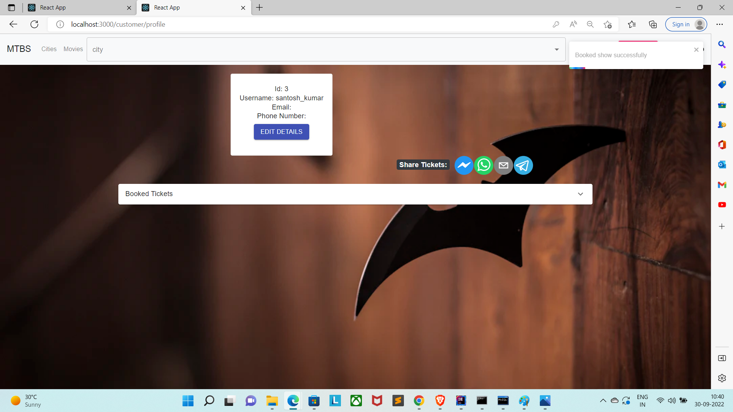
Customer/city/movie/show/booked:

